Slide 1
FRANK HERTZ EXPERIMENT

Slide 2
The existence of discrete energy levels were demonstrated by Frank Hertz in this Experiment
In the experiment, an electron beam is produced by thermionic emission from a filament. The electrons are accelerated, pass through the vapor, and are then retarded by a few volts before collection at the anode.

Slide 3
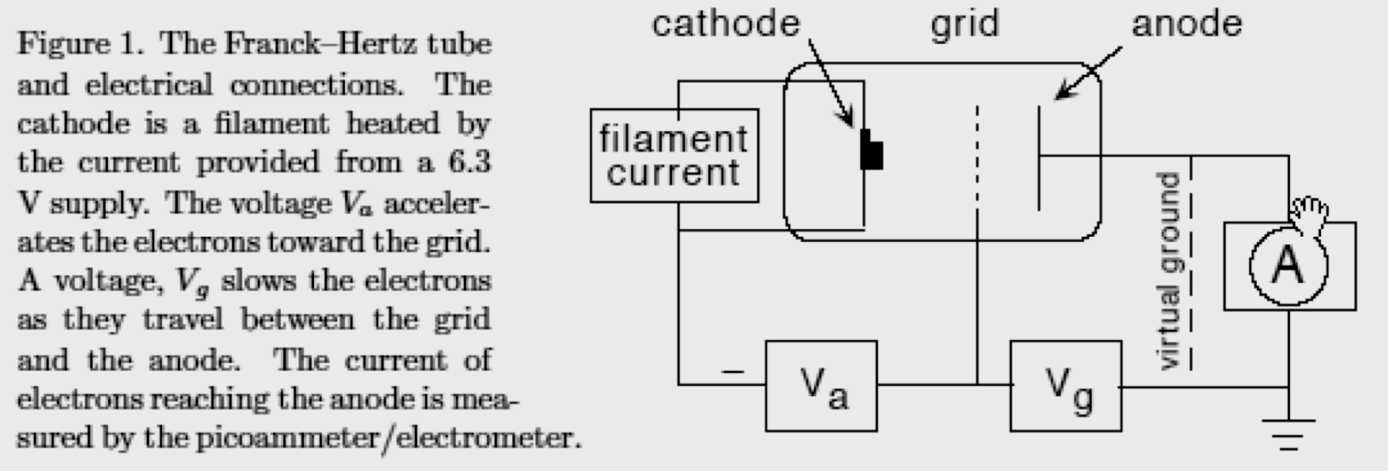
Experimental Arrangement
Glass tube
A Cathode to emit electrons
A Grid to accelerate electrons

Slide 4
WORKING
As the accelerating volt- age increases, the anode current increases because the electron trajectories are more focused, and the electrons are deflected less by scattering from the atoms of vapor in the tube. The anode current is observed to rise faster than linearly with Va .
The final energy of electrons that reach the grid is the initial energy, eVa , minus energy lost in collision.

Slide 5
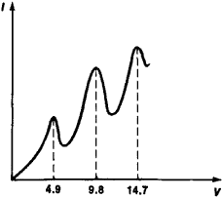
Results
As an electron passes through the vapor, it gains energy in the accelerating field produced by . At the point where the electron’s energy exceeds excitation , inelastic scattering becomes possible, and the electron scatters and loses almost all of its kinetic energy so that the process begins again. Thus multiple inelastic scatterings are possible as an electron moves from cathode to grid.

